Slide 1

Progress Report On : Fake News Detection using Machine Learning
Submitted in partial fulfilment of the requirements for the award of degree of
BACHELOR OF ENGINEERING
IN
(COMPUTER SCIENCE & ENGINEERING)
By
SOHAM BUTLEY
SONU SINGH
ROHAN PATIL
SIDDHI TELANG
VAISHNAVI BUTLE
Project guide :-
Prof. S.W.SHENDE

Slide 2
Table of Content
ABSTRACT
WORK PROGRESS
MACHINE LEARNING MODEL
RNN MODEL
SOFTWARE SETUP FOR DEVLOPMENT

Slide 3
Abstract
News is that part of communication that keeps us informed of the changing events, issues, and characters in the world outside.
News is important for several reasons within a society, Mainly to inform the public about events that are around them and may affect them.
News spread through word of mouth and traditional media and more recently through digital forms of communication such as edited videos, memes, unverified advertisements and social media propagated rumors.
As now a days many of people using social media in many cases people gets wrong and misleading information and people share that stories without verifying whether it is real or fake news stories. Now a days Fake news spread through social media become a serious problem, so there is a requirement for a structure which can find out fake news from real news.

Slide 4
Previous Work
In Phase 1 we had implemented model using basics ML Algorithms
We had trained our model using 4 ML Algos and found out its accuracy.
No | Model Name | Accuracy
1 | KNN Classifier | 95.60557341907824
2 | Random Forest Classifier | 99.14255091103966
3 | Logistic Regression | 99.67845659163987
4 | Naive Bayes | 96.89174705251877

Slide 5
Work progress
In Phase 2 we had Implemented RNN Model
We are build this project in 3 phases:
1. Machine Learning Model(Implemented)
2.RNN model(Implemented)
3. Website (Implemented)
WEBSITE -
The Website will have an UI through which the user can interact with the model.
The User has to input the news in the input section provided in the homepage.
So as soon as the user press the submit button the data will be sent to the backend ML model.

Slide 6
Machine Learning Model
The Model will train on the data, once it is trained it will predict the validity of the news.
As soon as the data reaches the ML model it will process it and predict outcome as Real or Fake
The predicted data will be sent to the website which will display it to the user.

Slide 7
RNN MODEL
The Model will train on the data, once it is trained it will predict the validity of the news in Boolean format.
As soon as the data reaches the RNN model it will process it and predict outcome as true or false
The predicted data will be sent to the website which will display it to the user.

Slide 8
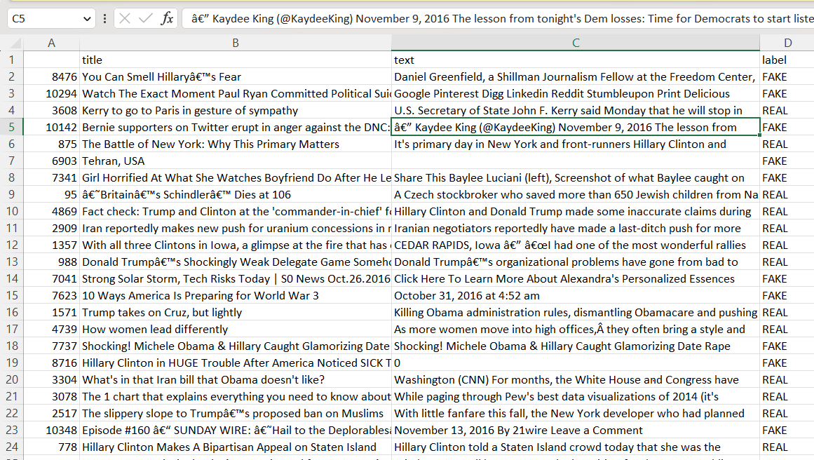
Dataset

Slide 9
RNN
A recurrent neural network (RNN) is a type of artificial neural network which uses sequential data or time series data
Distinguishing characteristic of recurrent networks is that they share parameters across each layer of the network.
Recurrent neural networks leverage backpropagation through time (BPTT) algorithm to determine the gradients, which is slightly different from traditional backpropagation as it is specific to sequence data.
RNN works on the principle of saving the output of a particular layer and feeding this back to the input in order to predict the output of the layer.

Slide 10
RNN ALGORITHM (LSTM)
LSTM networks are an extension of recurrent neural networks. (LSTM) mainly introduced to handle situations where RNNs fail.
LSTM is a novel recurrent network architecture training with an appropriate gradient-based learning algorithm.
LSTM is designed to overcome error back-flow problems. It can learn to bridge time intervals in excess of 1000 steps.
LSTM can approximate noisy problem domains, distributed representations, and continuous values.
Here we found out a huge accuracy of 99.84409799554566%

Slide 11
Software Setup for Development
Website-
Here we are developing the web module using python flask on VS Code.
Machine learning model & RNN model
For designing of ML model & RNN model we are using Google Collaboratory which is a free to use web software that develop ML and Cloud computing models.

Slide 12
Computational Requirements
Software Requirements:
VS Code
Chrome
Excel
Python 3.7
Hardware Requirement:
Processor: Core2Duo and above / AMD Ryzen Series
OS: Windows 7 and above/ Linux/ MacOS
RAM: Minimum 2GB
ROM : Minimum 2.5 GB

Slide 13
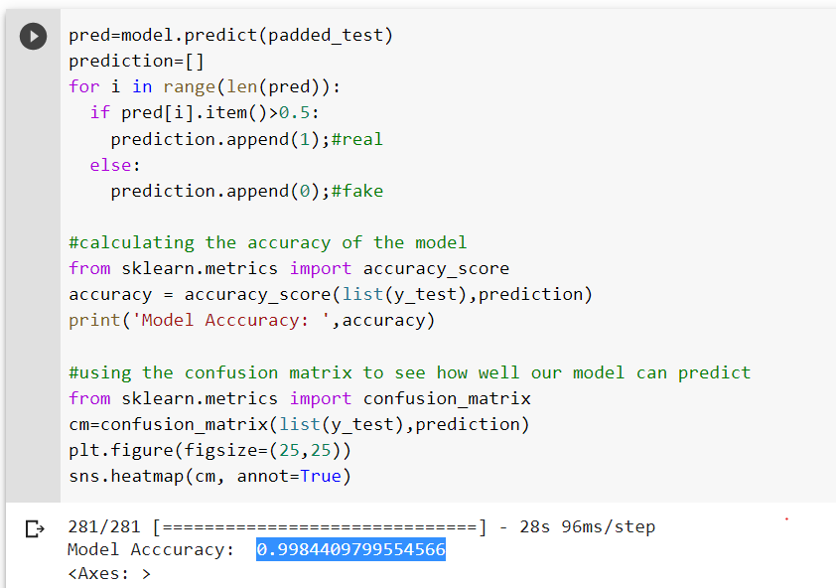
MODEL IMPLEMENTATION

Slide 14
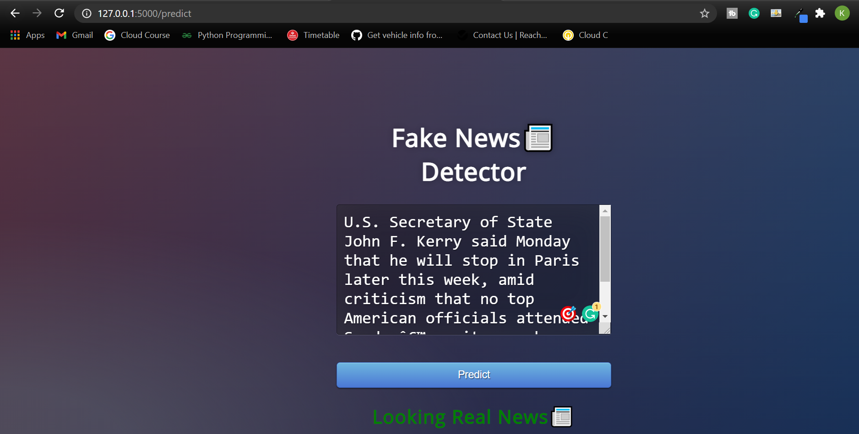
WEB App IMPLEMENTATION

Slide 15
THANK YOU …

